Slide 1
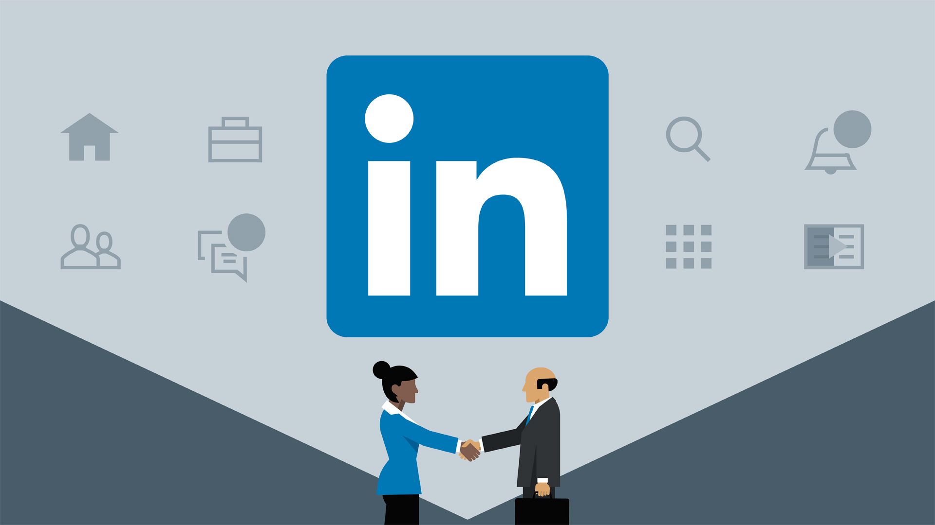
Social Media
LinkedIn

Slide 2
LinkedIn
LinkedIn is a business-oriented social networking site launched in 2003. It has 300+ million users across the world. It is available in 20 languages.
It allows users to create and customize profiles and connect with people having similar interest areas.
Presently, it is the largest platform for social networking, assisting people with job opportunities.
Jobseekers can connect and follow hiring managers and can update their profiles in a defined fashion to get easily discovered.

Slide 3
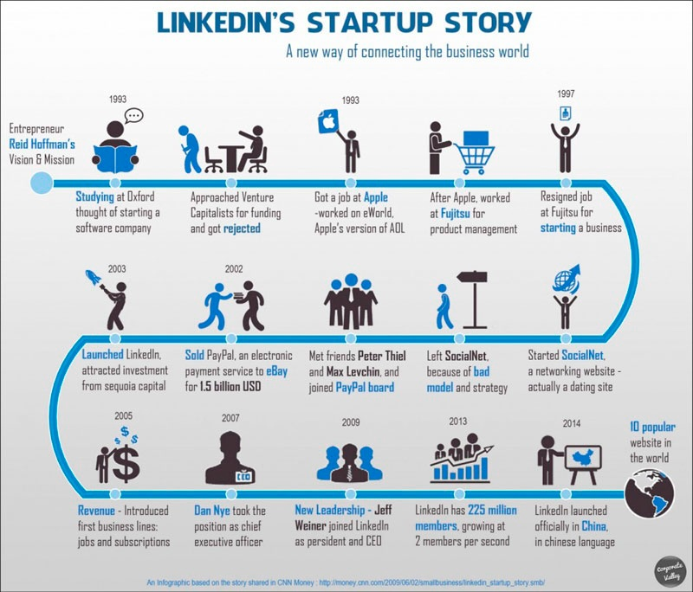
LinkedIn History
LinkedIn was founded in 2002 by Reid Hoffman and it was launched in 2003. Early on, its growth was slow, but it accelerated by the end of 2003.
In 2004, it introduced new features such as the ability to upload addresses to invite others and introduce groups and partners with American Express. It assorted 1 million members.
Jobs and subscriptions were introduced in 2005. Membership toll increased to 4 M.
In 2006, LinkedIn launched public profiles as your current and past career record.
In 2007, Reid Hoffman stepped aside and Dan Nye took over. Membership toll rises to 17 M.
In 2008, LinkedIn becomes global by opening its office in London and launching the Spanish and French version of the website.
In 2009, the membership count tipped over 50 million. Jeff Weiner joined LinkedIn as its CEO.
In 2010, LinkedIn grows amazingly with 90 million members and 1000 employees in 10 offices around the globe.
In 2011, LinkedIn became a publicly traded company on New York Stock Exchange and hosted a Town Hall meeting with Obama. Membership reaches 135 million.
The site was redesigned in 2012 focusing on making LinkedIn simpler and easy to use.
LinkedIn turned ten in 2013 with 225 million users across the globe.
By the end of 2014, Linkedin had grown to a significant extent with 315+ million registered users and well over 5000 employees in 27 cities. It continues to grow, adding features and delivering its users a better experience every time they log onto LinkedIn.

Slide 4
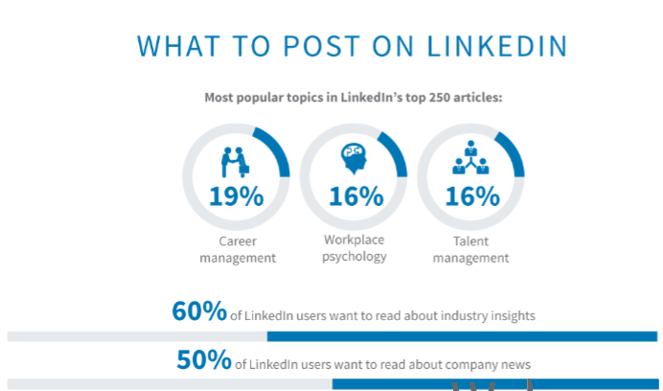
What to post on LinkedIn
Now that you know the best ways to post content, it's important to look at what to post.
Career management is the most common topic in LinkedIn's top 250 articles, making up nearly one out of five posts.
16% relate to workplace psychology, and 16% of them refer to talent management as well.
Altogether, 51% of LinkedIn's most popular articles — or 128 articles — fall into one of those three categories.
But that's not necessarily what LinkedIn users want to see now.
60% want to read about industry insights, and 50% of users want to read about company news.
Those are two major niches that any company can enter. If you want to build your LinkedIn following, start with those topics and build from there.

Slide 5
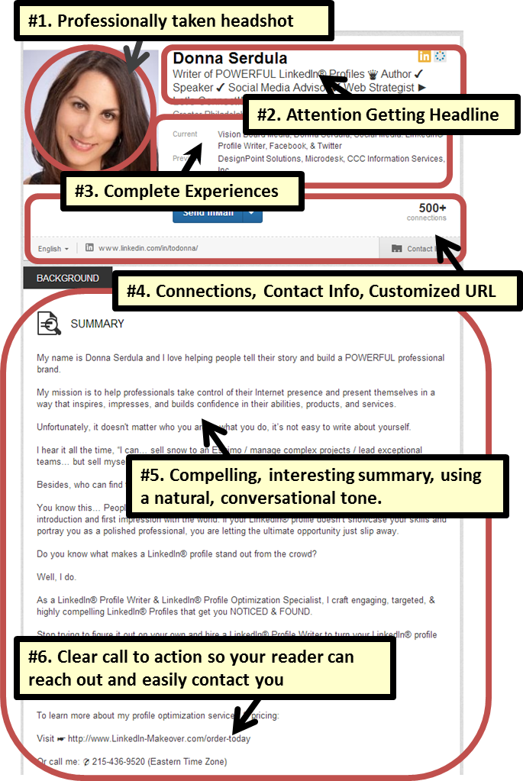
LinkedIn Personal Account
Manage your professional identity. Build and engage with your professional network. Access knowledge, insights and opportunities.
300 million+ members
Set-up your free profile (there are paid options as well).
Select a “professional” color photo of you looking direct to camera. Creativity can work, but can also backfire.
Complete your personal profile thoroughly and honestly – this is your online resume.
Connect to all your past and current contacts.
Reach out to your contacts from time to time or endorse their skills.
Participate in groups.

Slide 6
Premium Account
LinkedIn offers different levels of premium account options for people with different goals based on their specific needs.
LinkedIn Premium for General Users − starts at $24.95 per month. These plans include features such as InMail, seeing more profiles when you search, access to premium search filters, ability to view expanded profiles on LinkedIn, and more.
LinkedIn Premium for Recruiters − starts at $49.95 per month. These plans include talent-finding filters, saved searches with alerts for new candidates who meet your criteria, reference search, and more.
LinkedIn Premium for Job Seekers − starts at $19.95 per month. These plans include the ability to zero in on $100K plus jobs with detailed salary information, ability to move up to the top of the list as a featured applicant, access to the job seeker community, and more.
LinkedIn Premium for Sales Professionals − starts at $19.95 per month. These plans include a Lead Builder organizer, introductions to companies you are targeting, and more.
While some features exist only under specific accounts, such as featured applicant status for job seekers, most features are similar to the general user premium package.

Slide 7
Promote Your Business on LinkedIn
LinkedIn is a valuable marketing tool. It involves targeting your own network and creating more links from it. You can use the following tips to draw maximum benefit from LinkedIn −
Search for highly targeted clients. Set filters to refine your search so that they meet your business criteria.
Stay updated and in focus of customers. Keep in touch with them by messaging, feed, etc.
Post quality content. Keep posting new and correct information about your business. Make it viral.
Use sponsored post to reach the right audience.
Connect to relevant groups and circles and encourage your employees to be a part of it.
Customize your company page to make it compelling and descriptive. Use images, colors, and clips to describe what you have to offer.
Pay attention to your profile.
Maintain good relationship with your clients.

Slide 8
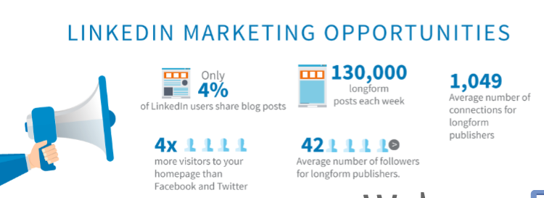
LinkedIn Marketing
LinkedIn is a professional networking platform and it has all the features of a great marketing opportunity provider. Here you interact with people who mean business. To market through LinkedIn, you need to do the following −
Build a robust business page that displays your products and services in a compelling format.
Invite clients and vendors to follow and recommend your page.
Launch a group that is related to your business. It can attract significant traffic.
Reach your audience through targeted advertising.
LinkedIn is a powerful social media tool. You just need to follow its policies and best practices.

Slide 9
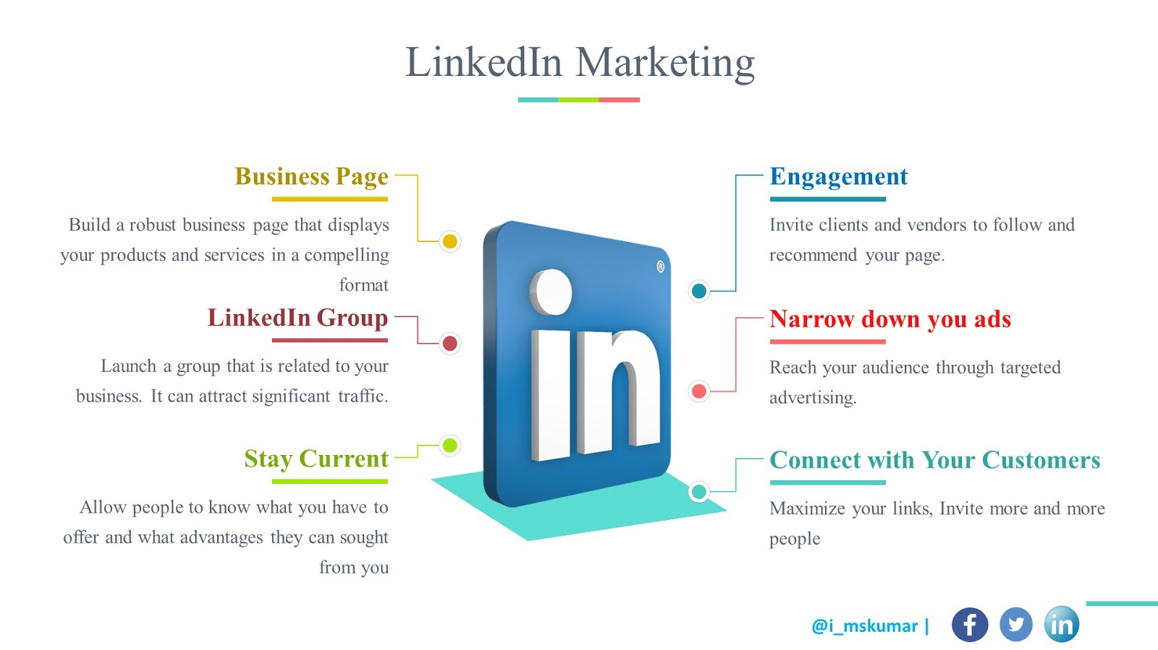
Advantages of LinkedIn Marketing
LinkedIn is a professional networking platform and it has all the features of a great marketing opportunity provider.
You can use LinkedIn to connect with other users and convert them into your clients. To do so, you need to:
Maximize your links that direct to catchy pages. These links can lure users to take interest in your products or services.
Invite more and more people. Connect to even second degree connections. Message them frequently. Keep interactions open.
Make your profile professional. It imbibes faith of your invitees in your business.
Stay current. Allow people to know what you have to offer and what advantages they can sought from you.

Slide 10
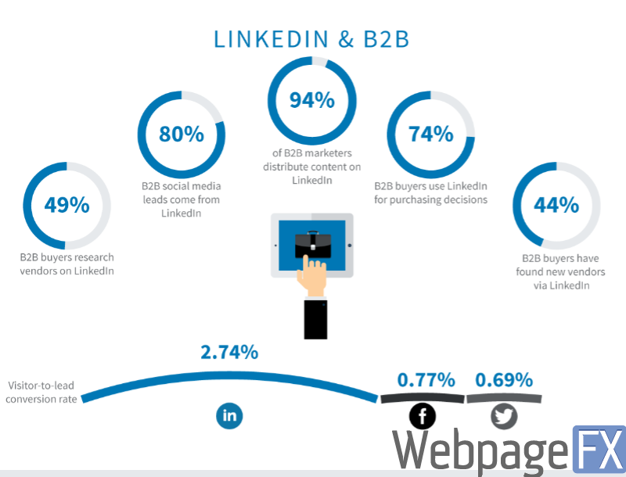
LinkedIn B2B advantages
LinkedIn provides a huge opportunity for B2B companies that want to reach new customers. Lots of marketers have already embraced that.
94% of B2B marketers publish content on LinkedIn, where some marketers get as many as 80% of their social media leads.
It's no wonder they get leads on LinkedIn, too. 74% of B2B buyers use LinkedIn to inform their purchasing decisions. 49% of them look at vendors in-depth, and 44% of them have bought from vendors that they found.
LinkedIn is also the best for getting new leads on your site.
LinkedIn has a 2.74% conversion rate for site visitors. That may sound low, but Facebook is 0.77%, and Twitter is only 0.69%.
So if you want to generate more leads, it's time to promote your business on LinkedIn

Slide 11
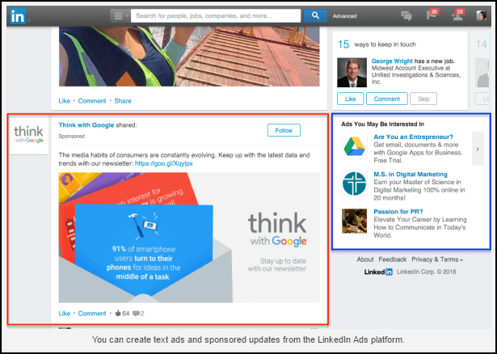
Create an Ad Campaign
To create an Ad campaign on LinkedIn, you need to log on to LinkedIn. Thereafter, follow the steps given below :
Select 'new campaign' and 'start New'.
Give a name to your campaign.
Choose your desired language.
Choose your media type − basic, video, etc.
Write your ad copy. Use 25 characters for heading and 75 characters for Body.
Include a desired call-to-action that is liable to convert.
Choose demographic areas and location you want your ad to be targeted in.
Choose payment methods between cost-per-click and cost-per-impressions.
Set a daily budget. This is the amount you are willing to pay on paid marketing through LinkedIn per day.
Decide conversion metrics and trace them regularly to get the scope of improvement.

Slide 12
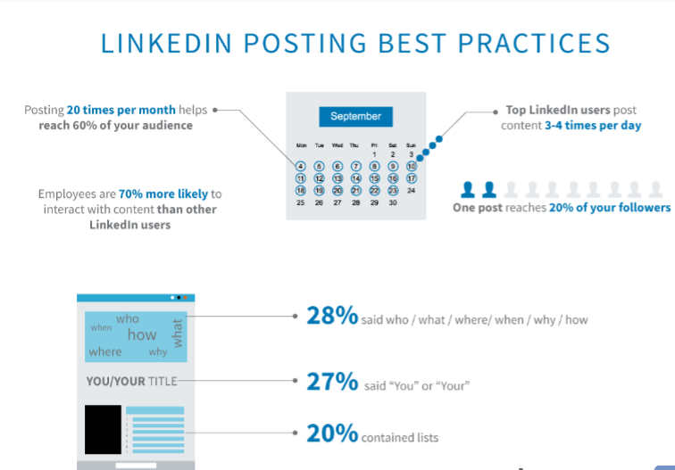
Posting Practices
First, it's smart to post about 20 times per month. That helps you reach 60% of your audience overall, including the people who follow or connect with you. Posting once reaches about 20% of your followers at a time.
The best LinkedIn users post far more than that — about three to four times per day.
LinkedIn also lets you use your employees to promote your business as well. Employees are 70% more likely to interact with content you publish than other LinkedIn users. That means free publicity, more potential followers, and more potential clients.
To draw initial attention, you can learn from some of the most successful posts on LinkedIn.
28% of the top 250 posts said who, what, where, when, why, or how in the titles. 27% said "you" or "your." Finally, 20% contained lists.
Altogether, these titling techniques give you an excellent starting point

